Slide 1


Project on
Data Science Job Market Analysis Across Multiple Job Platforms
(Naukri, Indeed, and LinkedIn)
Presented by :
Name : B. Bhanu Sai Prakash
Batch No : 436
Branch : Dilsukhnagar

Slide 2

About me
  I am Bhanu Sai Prakash Bandaru.
  I completed my B.Tech in Computer Science and Engineering from M.V.G.R College of Engineering(Vizianagaram).
  Linkedin : https://www.linkedin.com/in/bhanu-sai-prakash-bandaru-22a1b8204/
  Github : https://github.com/bhanusaiprakashbandaru

Slide 3

Agenda
Introduction & Problem Statement
Business Problem & Objectives
Data Collection & Preparation
Data Understanding & Cleaning
Exploratory Data Analysis
  Univariate Analysis
  Bivariate Analysis
  Multivariate Analysis
Hypothesis Testing
Key Insights & Recommendations
Conclusion
Q&A

Slide 4

Introduction
The data science job market in India is growing rapidly, with opportunities spread across multiple job portals.
Job seekers often rely on platforms like Naukri, Indeed, and LinkedIn to explore job opportunities.
However, each portal presents information differently, making it difficult to understand true market demand.
Job roles, required skills, experience levels, locations, and salary details are often inconsistent or incomplete.
As a result, career decisions are frequently based on assumptions rather than data.
This project aims to provide a data-driven understanding of the data science job market by consolidating and analyzing job postings from multiple portals.

Slide 5

Problem Statement
Job market information for data science roles is scattered across multiple job portals such as Naukri, Indeed, and LinkedIn.
Each portal presents job data in different formats with varying levels of detail.
Job seekers find it difficult to identify:
  In-demand roles
  Required skills
  Suitable experience levels
  High-opportunity locations
  Salary transparency trends
Due to the lack of a consolidated view, career decisions are often based on incomplete or misleading information.
This project aims to address this problem by collecting, cleaning, and analyzing job postings from multiple portals to provide a unified, data-driven view of the data science job market.

Slide 6
Business Problem Statement
Organizations such as training institutes, recruitment agencies, and workforce planners rely on job market data to guide career recommendations and hiring strategies.
However, job market insights derived from a single job portal provide only a partial and sometimes misleading view of actual demand.
Differences in job roles, skill requirements, experience levels, and salary disclosure across portals make it difficult to understand true market trends.
Without a consolidated and data-driven analysis, businesses and job seekers risk misaligned skill development and hiring decisions.
This project addresses the business problem by aggregating job postings from multiple portals and analyzing them to generate actionable insights into the data science job market.

Slide 7

Objective
Analyze data science job postings collected from multiple job portals to understand overall hiring trends.
Identify the most in-demand job roles in the data science domain.
Determine the most frequently required technical skills across roles.
Analyze experience-level distribution to assess market accessibility for freshers and early-career professionals.
Study location-wise job distribution to identify major hiring hubs.
Compare hiring patterns across Naukri, Indeed, and LinkedIn.
Examine salary disclosure behavior across roles and experience levels.

Slide 8
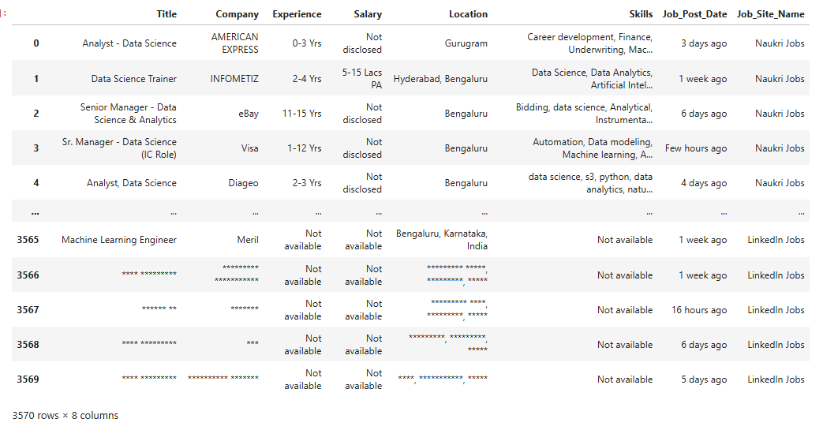
Data Collection & Merging
Job postings collected from Naukri, Indeed, and LinkedIn were merged into a single dataset.
All datasets were aligned using a common column structure.
A new column, Job_Site_Name, was added to identify the source job portal.
Merging allowed comparison of hiring patterns across different platforms.
Duplicate and inconsistent records became more visible after consolidation.

Slide 9
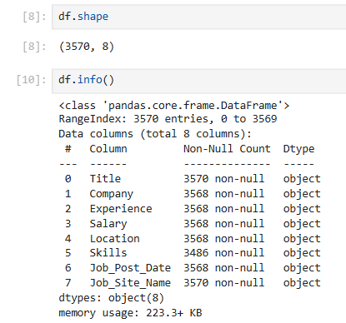
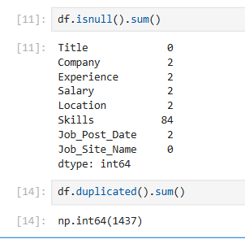
Data Understanding
Initial dataset contained 3570 job postings across 8 columns
Data included job title, company, experience, salary, location, skills, posting date, and job portal
Several columns had missing values, especially:
  Skills (84 missing)
  Salary, Experience, and Location contained business-level placeholders rather than true missing values (e.g., Not Available, Not Disclosed, Not Mentioned).
  1437 duplicate job postings detected due to:
  Same jobs reposted across multiple portals
  Repeated listings by companies
Duplicate records were identified but not removed at this stage
Raw job posting data was unstructured and inconsistent, requiring systematic cleaning before analysis

Slide 10
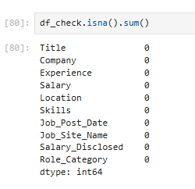

Data Cleaning
Raw job posting data contained masked, inconsistent, and incomplete values due to differences across job portals.
Handling Missing & Masked Values
True missing values (NaN) were replaced with meaningful business labels:
  Salary → Not Disclosed
  Experience → Not Mentioned
  Location → Not Mentioned
  Skills → Not Specified
  Job Post Date → Not Mentioned
Business placeholders such as Not Disclosed, Not Mentioned, and Not Available were retained and not treated as missing data.
Duplicate Record Handling
Duplicate job postings were identified using:
  Job Title
  Company
  Location
Duplicates occurred mainly due to:
  Same job posted across multiple job portals
  Repeated listings by companies
Duplicate postings were removed to avoid overestimating job demand.
Final Clean Dataset
Dataset size reduced from 3570 to 3319 job postings after
cleaning.
All fields contained valid, analysis-ready values.
Clean dataset enabled accurate EDA and hypothesis testing.
Cleaning improved data quality while preserving real-world
hiring patterns.

Slide 11
Data Features
Job Title – Role name as mentioned in the job posting
Company Name – Organization offering the job
Location – City or region of the job
Skills – Technical skills required for the role
Experience – Experience requirement mentioned
Salary – Compensation details (if disclosed)
Job Site Name – Source job portal (Naukri, Indeed, LinkedIn)
Job Posted Date – Date when the job was posted

Slide 12
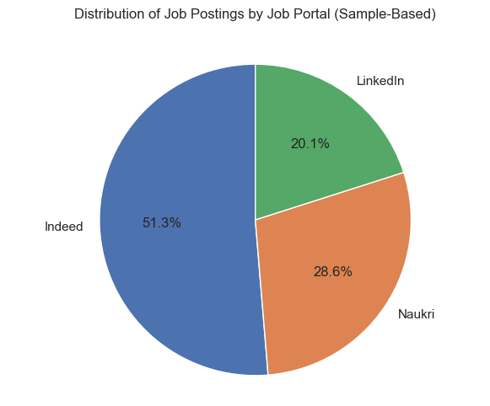
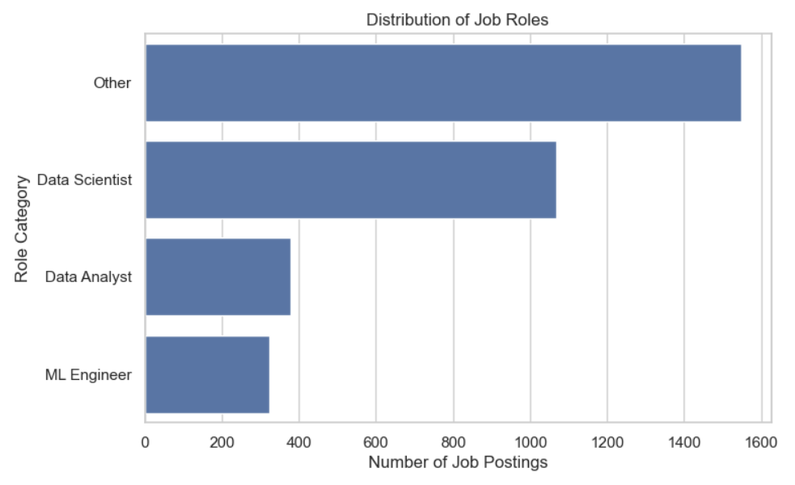
Univariate Analysis
Job Role Distribution
Job Postings by Job Portal
Data Scientist and Data Analyst roles dominate the market, while ML Engineer roles are fewer.
Indeed contributes the largest share of job postings, followed by Naukri, while LinkedIn has comparatively fewer listings.

Slide 13
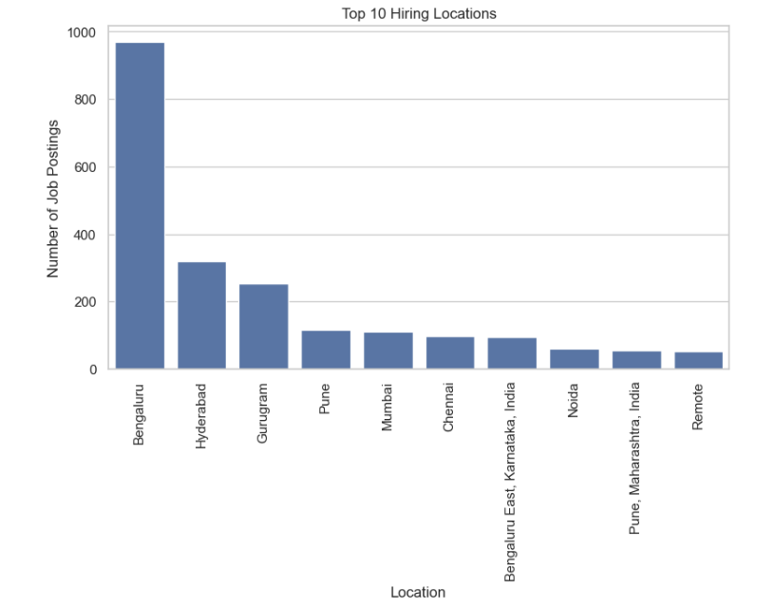
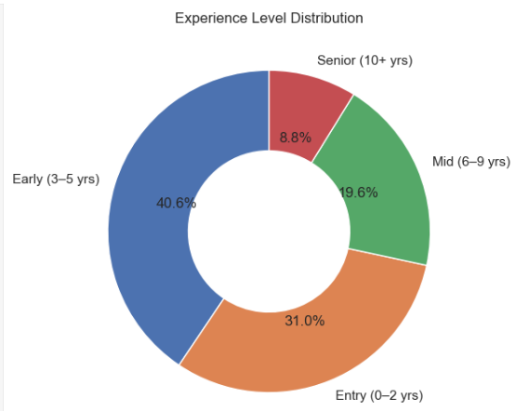
Univariate Analysis
Top Locations
Experience Distribution
Most job postings target entry-level and early-career professionals, with significantly fewer senior-level opportunities.
Bengaluru and Hyderabad lead in data science job postings, confirming their status as major tech hiring hubs.

Slide 14
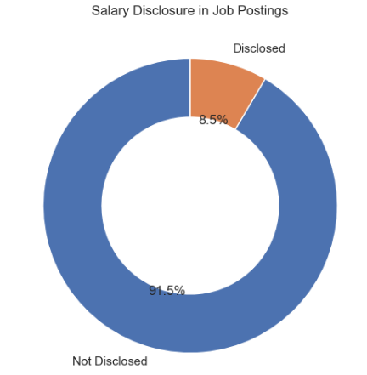
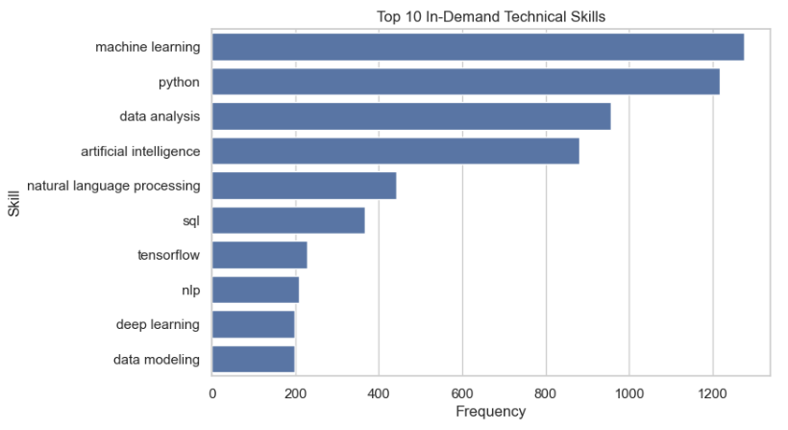
Univariate Analysis
Salary Disclosure Distribution
Top Skills
A large majority of job postings do not disclose salary information, indicating low transparency in compensation.
Python, Machine Learning, and Data Analytics are the most frequently demanded skills across data science roles.

Slide 15
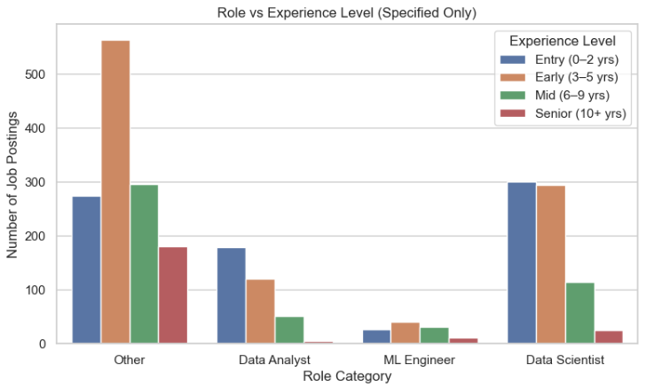
Bivariate Analysis
Which roles are hiring at which experience levels?
Data Scientist and Data Analyst roles are heavily concentrated at entry and early-career levels, while ML Engineer roles show relatively higher demand at mid and senior experience levels, indicating greater specialization requirements.

Slide 16
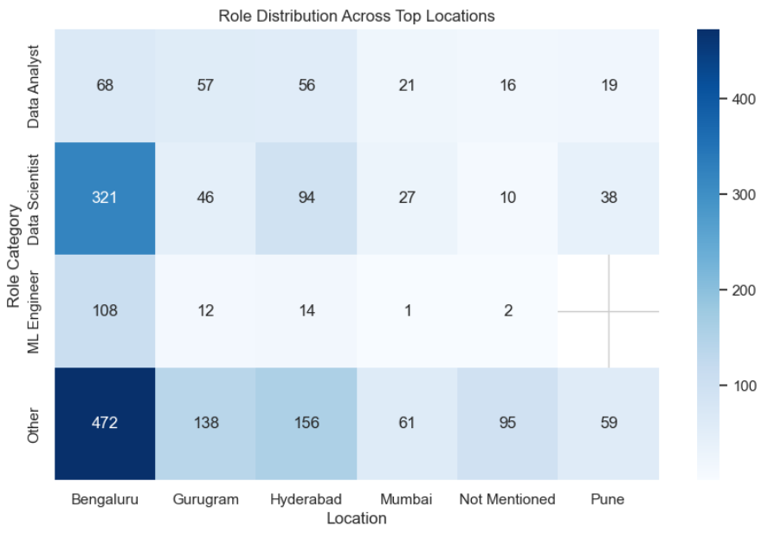
Bivariate Analysis
How are different job roles distributed across major hiring locations in India?
Data Scientist roles are heavily concentrated in Bengaluru and Hyderabad, confirming their dominance as data hubs, while ML Engineer roles show tighter geographic clustering, indicating specialized hiring ecosystems.

Slide 17
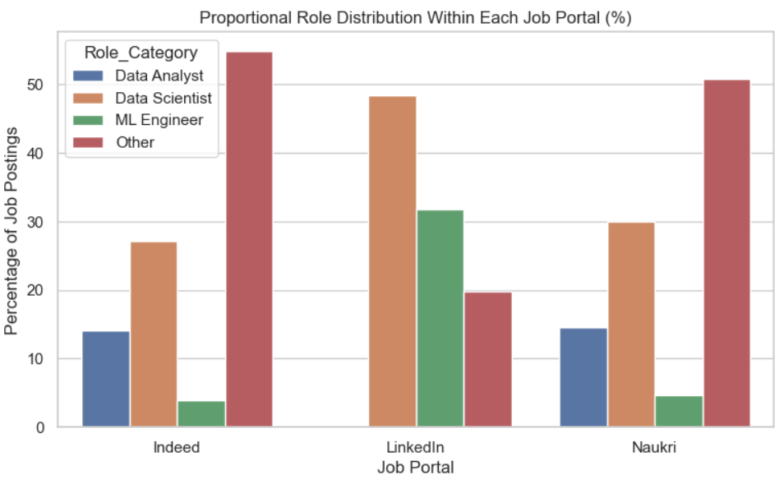
Bivariate Analysis
How does the distribution of job roles vary across different job portals?
LinkedIn is heavily skewed toward Data Scientist and ML Engineer roles, indicating demand for specialized talent, while Indeed and Naukri show a broader mix of roles, reflecting more generalized and mass-market hiring patterns.

Slide 18
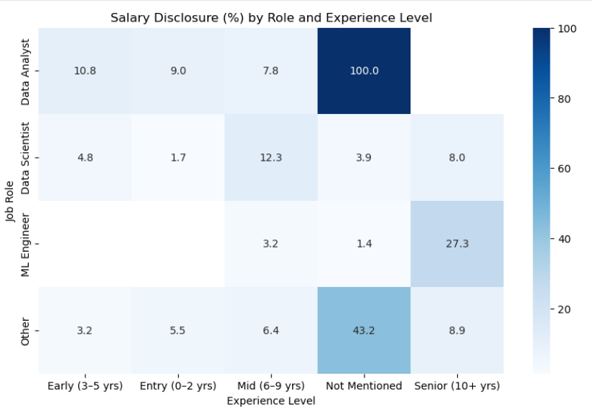
Multivariate Analysis
How does salary disclosure vary across job roles and experience levels?
Most job postings do not show salary information.
Entry and early-career jobs are more likely to show salary than senior jobs.
As experience increases, salary details are shared less often.
ML Engineer roles hide salary information more than other roles.
Jobs without clear experience details show mixed salary visibility.

Slide 19
Hypothesis Testing
Hypothesis 1: Do Different Job Roles Demand Different Skill Sets?
Question: Is skill demand dependent on job role?
Hypotheses
H₀ (Null Hypothesis):
Skill requirements are the same across all job roles.
H₁ (Alternative Hypothesis):
Skill requirements vary across job roles.
Method Used: Chi-Square Test of Independence between Job Role and Skill Requirement (e.g., Python).
Result: The relationship is statistically significant (p < 0.05), indicating that the observed differences are unlikely due to random chance.
Conclusion: Different job roles require different skill sets. Data Scientist and ML Engineer roles show higher dependency on advanced technical skills, while analyst roles require comparatively broader but less specialized skill combinations.

Slide 20
Hypothesis Testing
Hypothesis 2: Does Job Role Influence Salary Disclosure?
Question: Is salary disclosure significantly different across job roles?
Hypotheses
H₀ (Null Hypothesis):
Salary disclosure is independent of job role.
H₁ (Alternative Hypothesis):
Salary disclosure varies significantly by job role.
Method Used: Chi-Square Test of Independence between Job Role and Salary Disclosure.
Result: The relationship is statistically significant (p < 0.05), indicating that the observed differences are unlikely due to random chance.
Conclusion: Salary disclosure varies by job role. Entry-level and analyst roles disclose salary more often, while Senior and specialized roles are less likely to disclose salary information, indicating negotiation-driven hiring for high-impact roles.

Slide 21
Key Insights & Recommendations
For Job Seekers
Focus on Python, ML, SQL, and Data Analytics — these skills appear most consistently.
Entry and early-career roles dominate the market, making them the easiest entry points.
Salary is often not disclosed, especially for senior roles — be prepared to negotiate.
For Employers
Disclosing salary ranges improves candidate quality and reduces mismatches.
Clear skill requirements attract role-aligned candidates and reduce irrelevant applications.
Hiring demand varies by city — location-specific hiring works better than uniform postings.
For Recruiters & Job Platforms
Different platforms attract different role types — posting strategy should match the platform.
Standardized job titles and skill tags improve search accuracy and candidate matching.
Better salary and skill metadata increases transparency and platform credibility.

Slide 22
Summary page
Conclusion
The data science job market in India is highly skill-driven, with demand concentrated around Data Scientist, Data Analyst, and ML Engineer roles.
Python, Machine Learning, SQL, and Data Analytics are the most consistently required skills across job postings.
Early and mid-career roles dominate the market, while senior positions are fewer and more selective.
Salary transparency is low, especially for senior and specialized roles, indicating negotiation-based hiring practices.
Job opportunities are geographically concentrated, with Bengaluru and Hyderabad emerging as major data hubs.
Different job portals show distinct hiring patterns, making multi-platform analysis essential for accurate market understanding.
Notes:
textbox
No alt text provided
textbox
No alt text provided
textbox
No alt text provided
textbox
No alt text provided
textbox
No alt text provided
textbox
No alt text provided
textbox
No alt text provided
textbox
No alt text provided
actionButton
No alt text provided

Slide 23
?
Any
Questions

Slide 24

Thank you

